Slide 1
Critical sections, locks

Slide 2
Recap
Threads have
  Private registers
    context switching saves and restores registers when switching from thread to thread
  Shared “global” memory
    global means not stack memory

Slide 3
Shared counter
Two threads updating a single shared variable “cnt”
What happens when two threads execute concurrently?
Shared data
int cnt = 0;
void * worker( void *ptr )
{
int i;
for (i = 0; i < ITERATIONS_PER_THREAD; i++)
cnt++;
}

Slide 4
Order of execution of threads
Possible implementation of cnt++:
register ← cnt // read
      register ← register + 1 // modify
      cnt ← register // write
OS might decide to context switch from one thread to another at any time.
Thus the atomic actions of concurrent threads may be interleaved in any possible order

Slide 5
Possible interleaving
register_{i} denotes the value of register in thread i
register₁ ← cnt
register₁ ← register₁ + 1
<switch>
register₂ ← cnt
register₂ ← register₂ + 1
cnt ← register₂
<switch>
cnt ← register₁
Result: cnt one less than correct! (lost update)

Slide 6
Practice Exercise
Which values might the shared variable s hold after both threads finish?
  30
  20 or 30
  20, 30, or 50
  Another set of values
threadA()
{ int a, b;
a = getShared();
b = 10;
a = a + b;
saveShared(a);
return a;
}
threadB()
{ int a, b;
a = getShared();
b = 20;
a = a - b;
saveShared(a);
return a;
}
Shared memory
s = 40

Slide 7
Pop Quiz
Output?
int i = 0;
void *doit(void *vargp)
{
i = i + 5;
}
int main()
{
pthread_t tid;
pthread_create(&tid, NULL, doit, NULL);
i = i + 3;
pthread_join(tid, NULL);
printf(“%d”, i);
}

Slide 8
Critical section
Critical section – code that access shared resource (e.g., variable or data structure)
Race condition – arises when multiple threads simultaneously enter critical section leading to non-deterministic outcome
Important: Critical sections in different threads are not necessarily the same code segment!

Slide 9
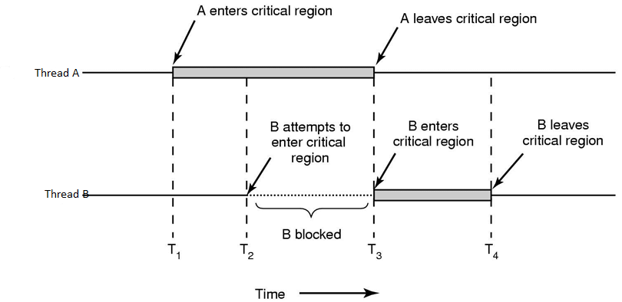
Critical section requirements
Mutual exclusion (safety property)
  At most one thread can be in CS at a time

Slide 10
Critical section requirements
Liveness properties
Progress
  if no thread in critical section a thread can enter without waiting
Bounded waiting
  once a thread T starts trying to enter the CS, there is a bound on the number of times other threads get in

Slide 11
Shared counter: New version
Thread 1:
Enter CS;
count++;
Leave CS;
How to implement Enter CS and Leave CS?
Thread 2:
Enter CS;
count++;
Leave CS;

Slide 12
Implementation: First try
Thread 1:
while (busy) { ; }
busy = 1;
count++;
busy = 0;
Is this a valid solution?
Thread 2:
while (busy) { ; }
busy = 1;
count++;
busy = 0;

Slide 13
Exercise
Show through an example that the solution violates mutual exclusion.
while (busy) { ; }
busy = 1
  count++
  Both hreads access count at the same time
while (busy) {;}
busy = 1
count++

Slide 14
Exercise
Show through an example that the solution violates bounded waiting.
while (busy) { ; }
busy = 1
count++
busy = 0
  while (busy) {;}
  busy = 1
With a bad interleaving of threads, Thread 2 never gets access to count …
while (busy) {;}
while (busy) {;}

Slide 15
Locks (mutexes)
Locks guarantee mutual exclusion
Multiple threads calling lock() result in exactly one thread acquiring the lock
  Thread T’s lock() call returns: T holding the lock
  Other threads block on lock(), waiting for the lock to become available

Slide 16
Locks (mutexes)
A thread that is holding the lock calls unlock() to release the lock
  T’s unlock() call returns; the lock becomes available
  Another thread waiting for the lock may succeed in acquiring it

Slide 17
Locks: Usage example
1 #define MAX_ITER 1000000000
2 long counter = 0;
3 pthread_mutex_t mylock = PTHREAD_MUTEX_INITIALIZER;
4
5 void * thread_function(void * arg) {
6 long l;
7 for (l=0; l < MAX_ITER; l++) {
8 pthread_mutex_lock(&mylock);
9 counter = counter + 1; //critical section
10 pthread_mutex_unlock(&mylock);
11 }
12 }
In line 3, a mutex named “mylock” is declared.
Before a thread enters the critical section, it locks the mutex (Line 8).
When a thread leaves the critical section, it unlocks the mutex (Line 10).
The mutex ensures that at any time, only one thread will be allowed into the critical section. All other threads have to wait until the critical section becomes free again.

Slide 18
Program example
To sum the elements of an array, a[1000]:
int sum, a[1000];
sum = 0;
for (i = 0; i < 1000; i++)
sum = sum + a[i];

Slide 19
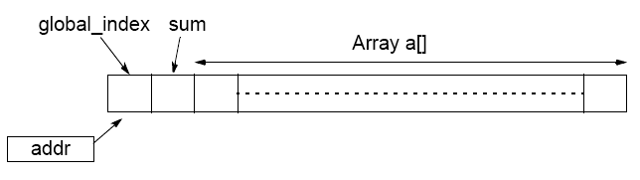
Pthreads program example
Modified within critical sections
n threads created, each taking numbers from list to add to their local partial sums. When all numbers taken, threads can add their partial sums to a shared location sum.
Shared location global_index used by each thread to select next element of a[]. After global_index read, it is incremented in preparation for next element to be read.

Slide 20
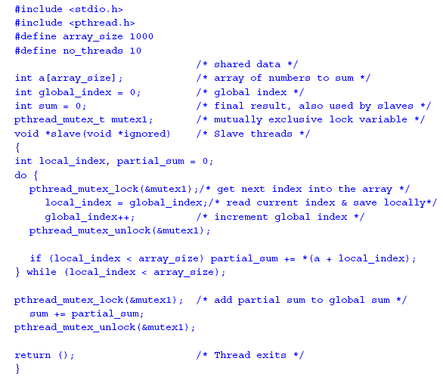

Slide 21
